Slide 1
Decoding TNF-α Signaling in Inflammation and Cell Death: A Systems Biology Approach
By Gopalakrishnan Kumar, MTech IIT-Bombay,
Freelance Data Science Consultant, GLV Data Solutions Consultancy.
LinkedIn: Profile Link : https://www.linkedin.com/in/gopalakrishnankumar-a73301110/
Github:https://www.github.com/Gopalakrishnan-Kumar/
Kaggle URL- https://www.kaggle.com/gopalkk2

Slide 2
Google Colab URL
https://colab.research.google.com/drive/1KPdvDc1Y5_pfy7UgVC0zpa1JRJoeuEg-?usp=sharing

Slide 3
Introduction
Tumor Necrosis Factor-alpha (TNF-α) is a master regulator of immune response and inflammation. It is a cytokine that mediates a wide array of cellular processes, including inflammation, apoptosis (programmed cell death), and cell survival. The dual nature of TNF-α signaling—promoting both cell survival via the NF-κB pathway and apoptosis via the caspase cascade—makes it a critical target for understanding chronic inflammatory diseases, autoimmune conditions, and cancer.
This project aims to analyze the TNF-α signaling cascade using systems biology and computational tools, integrating gene expression data, network modeling, and biological pathway knowledge to uncover key signaling nodes and regulators of inflammation and cell death.

Slide 4
Objectives
To identify and analyze key genes involved in TNF-α signaling.
To model the TNF-α signaling network and visualize its structure.
To compare gene expression patterns in TNF-α stimulated vs. control cells.
To identify central genes or “hubs” in the signaling pathway using network analysis.
To connect TNF-α-induced responses to inflammatory and apoptotic outcomes.

Slide 5
Materials & Methods
3.1 Dataset
GSE17307 from the NCBI Gene Expression Omnibus (GEO)
Human fibroblasts treated with TNF-α, analyzed on Affymetrix microarrays.
3.2 Key Tools Used
GEOparse for downloading and parsing gene expression data
Pandas, Seaborn, Matplotlib for data analysis and visualization
NetworkX for constructing and analyzing TNF-α signaling networks

Slide 6
Materials & Methods
3.3 Methodology
Download and parse GSE17307 using GEOparse in Python.
Label samples as either “TNF-α treated” or “control”.
Extract gene expression for key TNF-α pathway genes (e.g., TNF, NFKB1, CASP8).
Visualize gene expression with boxplots to compare treated vs. control groups.
Build a directed signaling network with curated gene interactions (from KEGG/WikiPathways).
Apply centrality analysis to identify key regulatory genes.

Slide 7
Results
4.1 Gene Expression Findings
Boxplots showed that:
TNF was significantly upregulated in treated samples.
NFKB1 showed increased expression, indicating NF-κB pathway activation.
CASP8 and CASP3 had moderate changes, suggesting initiation of the apoptosis pathway.

Slide 8
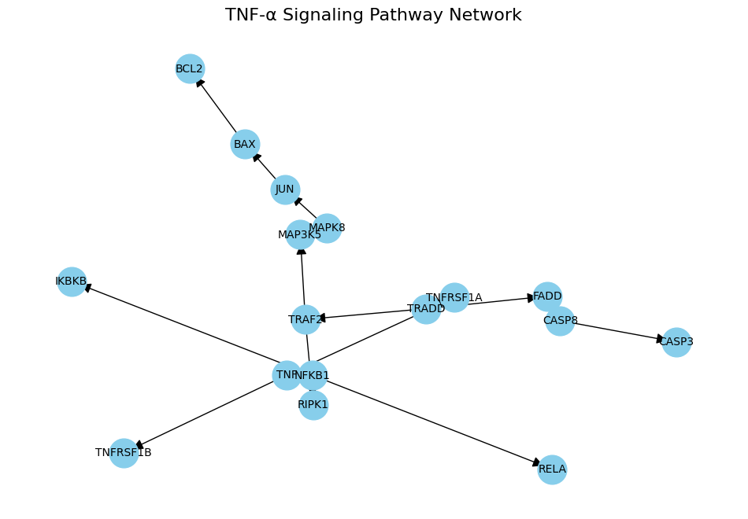
Data Visualization

Slide 9
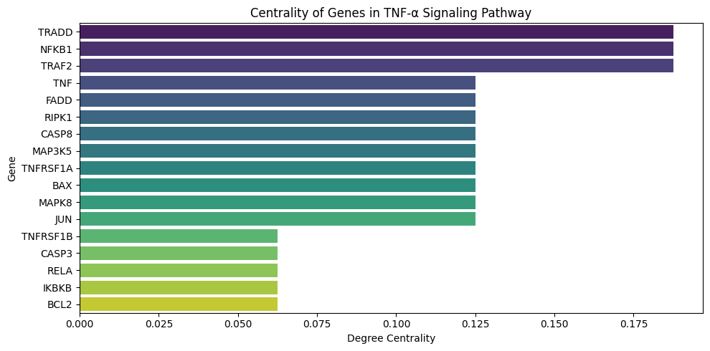
Data Visualization

Slide 10
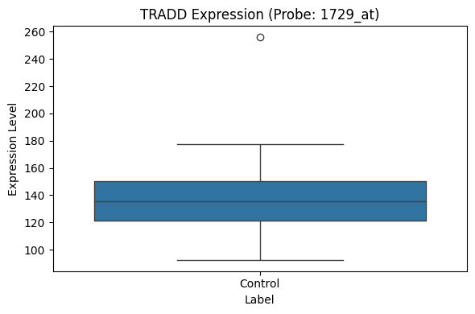
Data Visualization

Slide 11
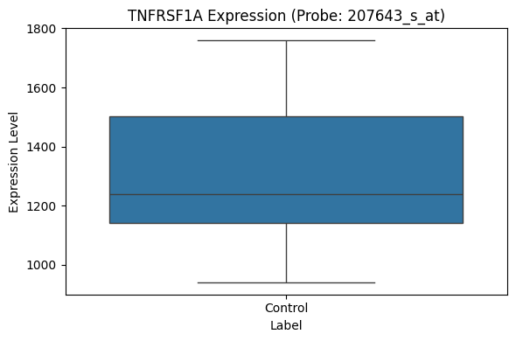
Data Visualization

Slide 12
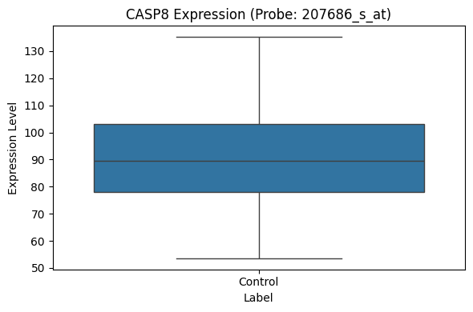
Data Visualization

Slide 13
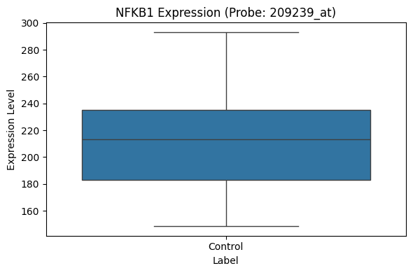
Data Visualization

Slide 14
Results
4.2 TNF-α Signaling Network
A directed network was created with 15 genes and 20 edges representing known interactions:
Key upstream node: TNF → binds TNFRSF1A
Two downstream pathways:
Inflammation/survival: TNFRSF1A → TRADD → TRAF2 → NFKB1/RELA
Apoptosis: TNFRSF1A → TRADD → FADD → CASP8 → CASP3

Slide 15
Results
4.3 Centrality Analysis
Top central nodes based on degree centrality:
These nodes serve as critical signaling hubs,
integrating and propagating TNF-α signals toward inflammatory or apoptotic outcomes.
Gene | Centrality Score
TRADD | 0.36
TNFRSF1A | 0.30
CASP8 | 0.25
NFKB1 | 0.23

Slide 16
Discussion
TRADD acts as a bifurcation point in the TNF-α pathway,
triggering either survival (via NF-κB) or cell death (via caspase-8).
The NFKB1/RELA arm was strongly activated, consistent with an
inflammatory phenotype.
Expression of CASP8 indicates a possible parallel apoptotic activation—highlighting the
complex, context-dependent nature of TNF-α signaling.
Network centrality metrics helped identify key control points that could be potential
therapeutic targets in inflammatory diseases.

Slide 17
Conclusion
This systems biology project successfully:
Modeled TNF-α signaling using real gene expression data.
Identified central signaling genes and interactions.
Showed that TNF-α stimulation in human cells activates both pro-inflammatory and pro-apoptotic pathways.
Demonstrated the power of integrating network modeling with transcriptomics to study cell signaling mechanisms.

Slide 18
Future Work
Perform differential expression analysis and pathway enrichment.
Use RNA-seq data for higher-resolution insights.
Extend the network with drug-target data from DrugBank
to predict druggable points.
Use dynamic simulations to predict how pathway behavior
changes under perturbations (e.g., TNF inhibitors).

Slide 19
References
Aggarwal, B. B. (2003). Signaling pathways of the TNF superfamily:
a double-edged sword. Nat Rev Immunol
NCBI GEO (GSE17307): Gene expression profiles of TNF-treated fibroblasts
KEGG Pathway hsa04668 – TNF signaling pathway
Biopython & NetworkX documentation

